Slide 1
Antibody Choice and Use
for Research Integrity
and Reproducibility
[YOUR NAME]
NC3Rs / OGA Antibody Champion
[YOUR INSTITUTION]
onlygoodantibodies.co.uk
Notes:
TITLE SLIDE Introduce yourself and your role as an Antibody Champion. Briefly explain what the programme is: "I'm [name], an NC3Rs and OGA Antibody Champion at [institution]. The Champions programme is a joint initiative between the Only Good Antibodies community and the NC3Rs, training early career researchers to drive better antibody practices at their institutions. Today I'm going to show you why antibody choice matters and what you can do about it."

Slide 2
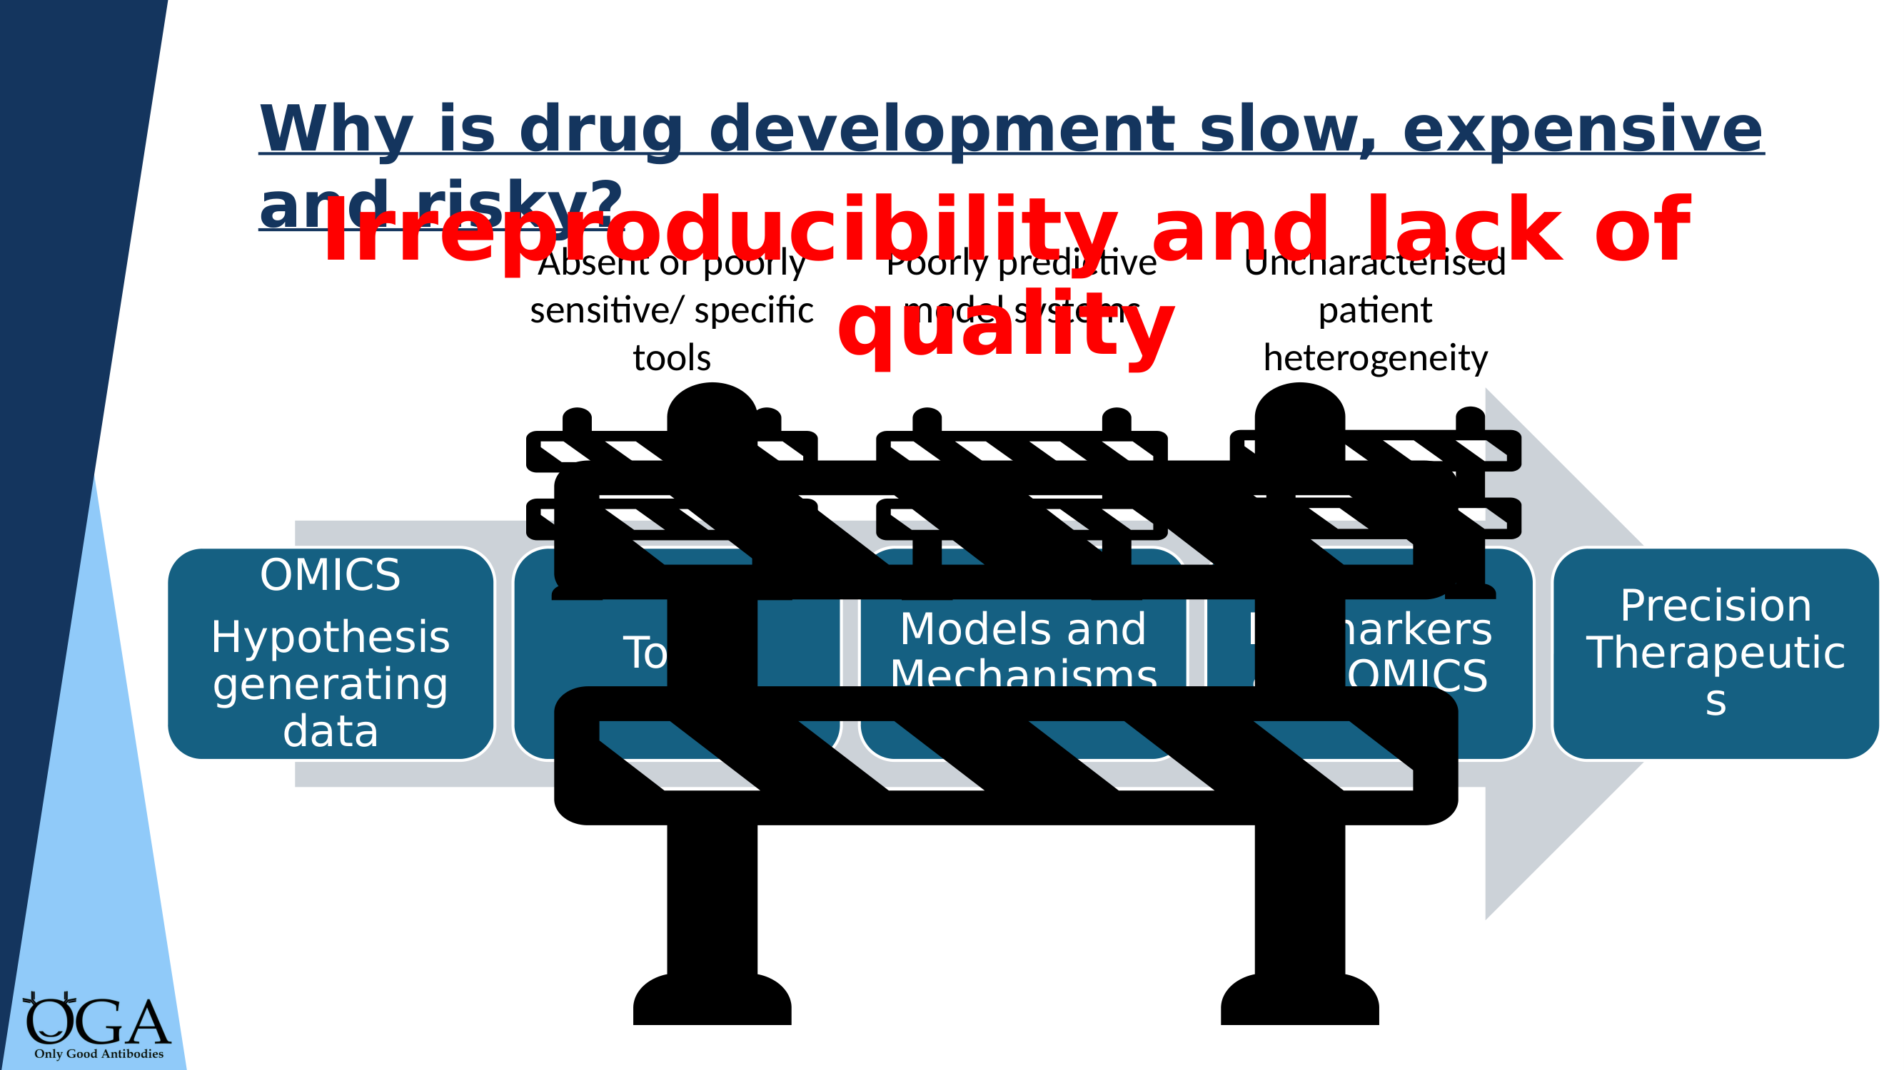
KEY MESSAGE: Poor-quality tools — especially antibodies — are a major bottleneck in translational research
Notes:
WHY IS DRUG DEVELOPMENT SLOW? This slide shows the translational pipeline: from hypothesis-generating omics data, through tools, models, biomarkers, to precision therapeutics. The barrier icon represents where absent or poorly specific tools block progress. "Drug development is expensive and slow partly because of irreproducibility. And one of the biggest causes of irreproducibility is the tools we use — particularly antibodies. If your antibody isn't detecting what you think it is, everything downstream is built on a false foundation." Key point: antibodies sit right at the 'tools' stage — they affect everything that follows.

Slide 3
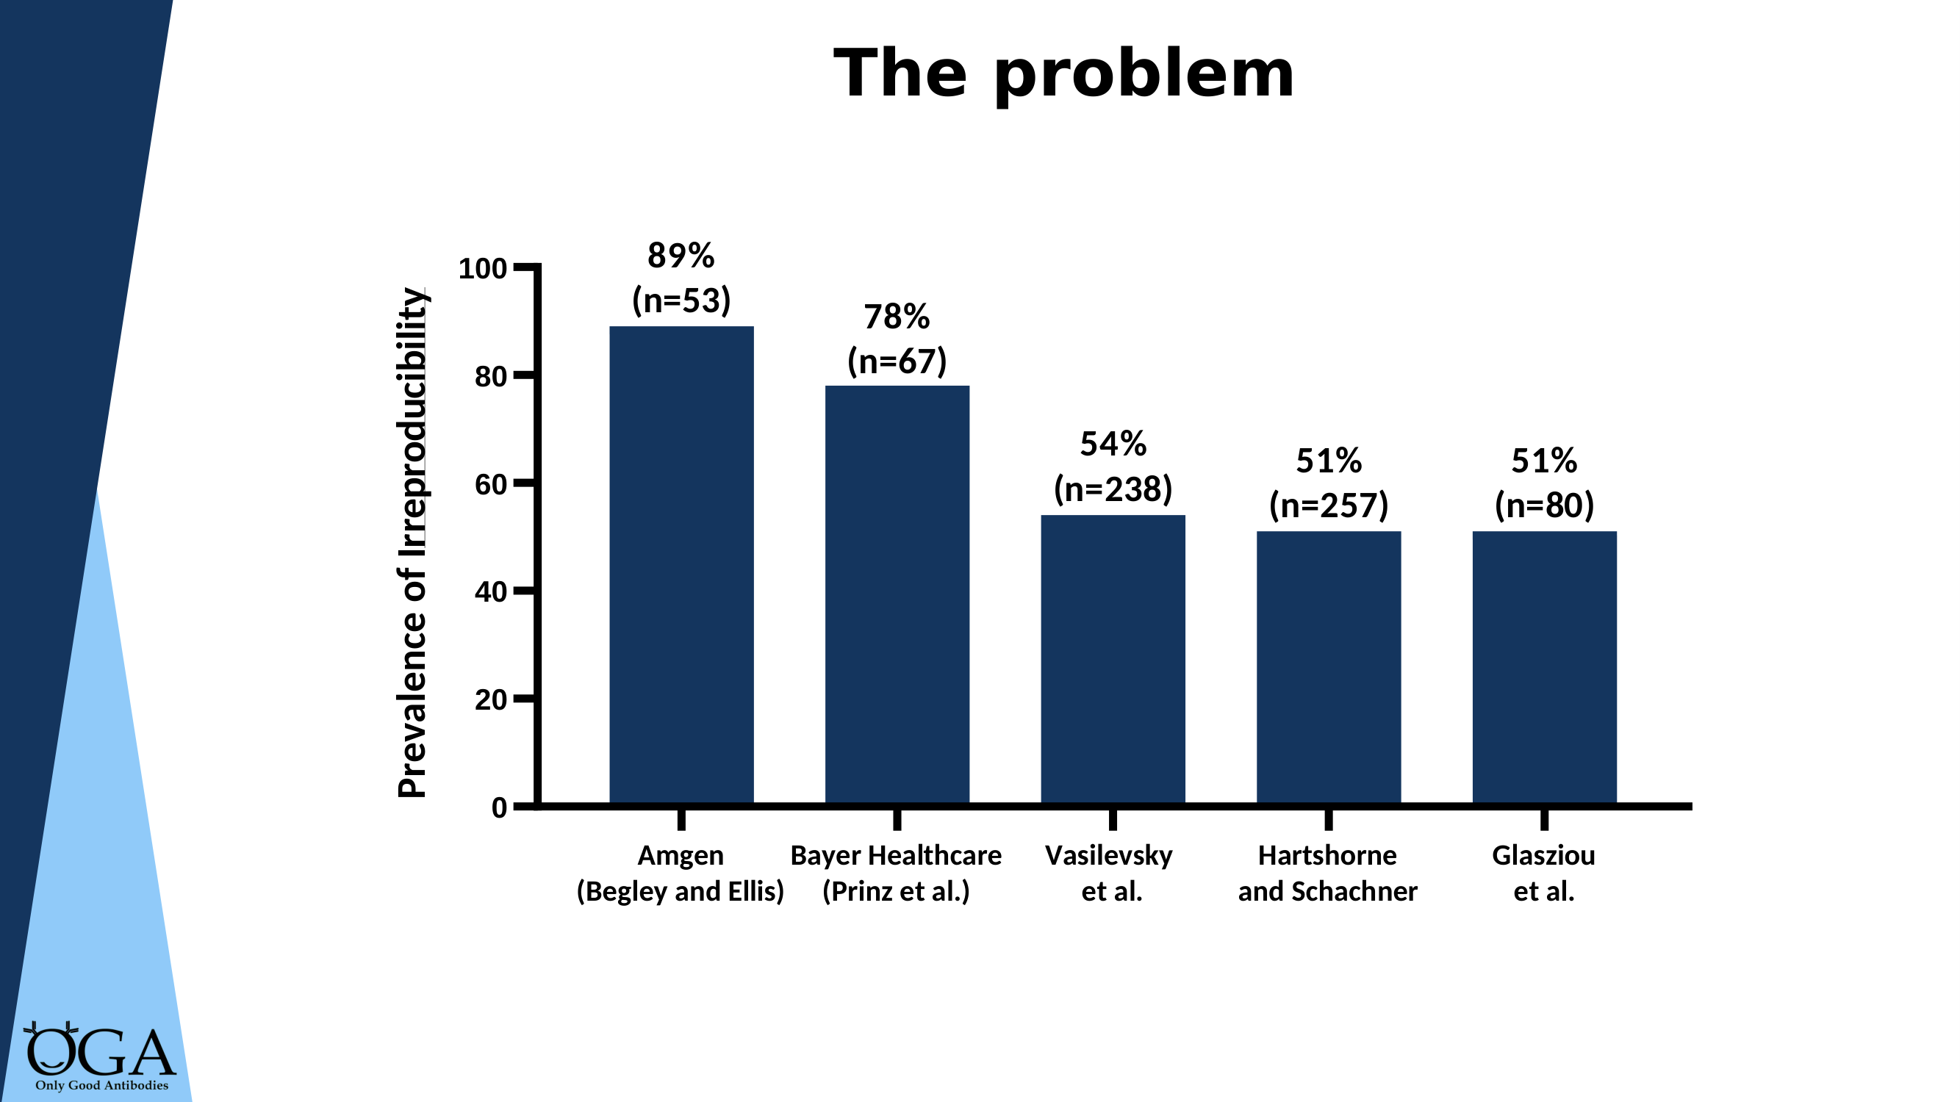
KEY MESSAGE: 50–89% of preclinical studies cannot be reproduced — this is not a minor problem
Notes:
THE PREVALENCE OF IRREPRODUCIBILITY Five independent studies all showing the same picture: at least half of preclinical research is not reproducible. "Amgen tried to reproduce 53 landmark cancer studies — 89% failed. Bayer Healthcare had similar results with 67 studies. Multiple other groups found rates of 50–54%. This is not one bad study — it's a consistent finding across different teams and methods." Let these numbers sink in. Pause after stating them. Reference: Freedman et al., PLoS Biology 2015.

Slide 4
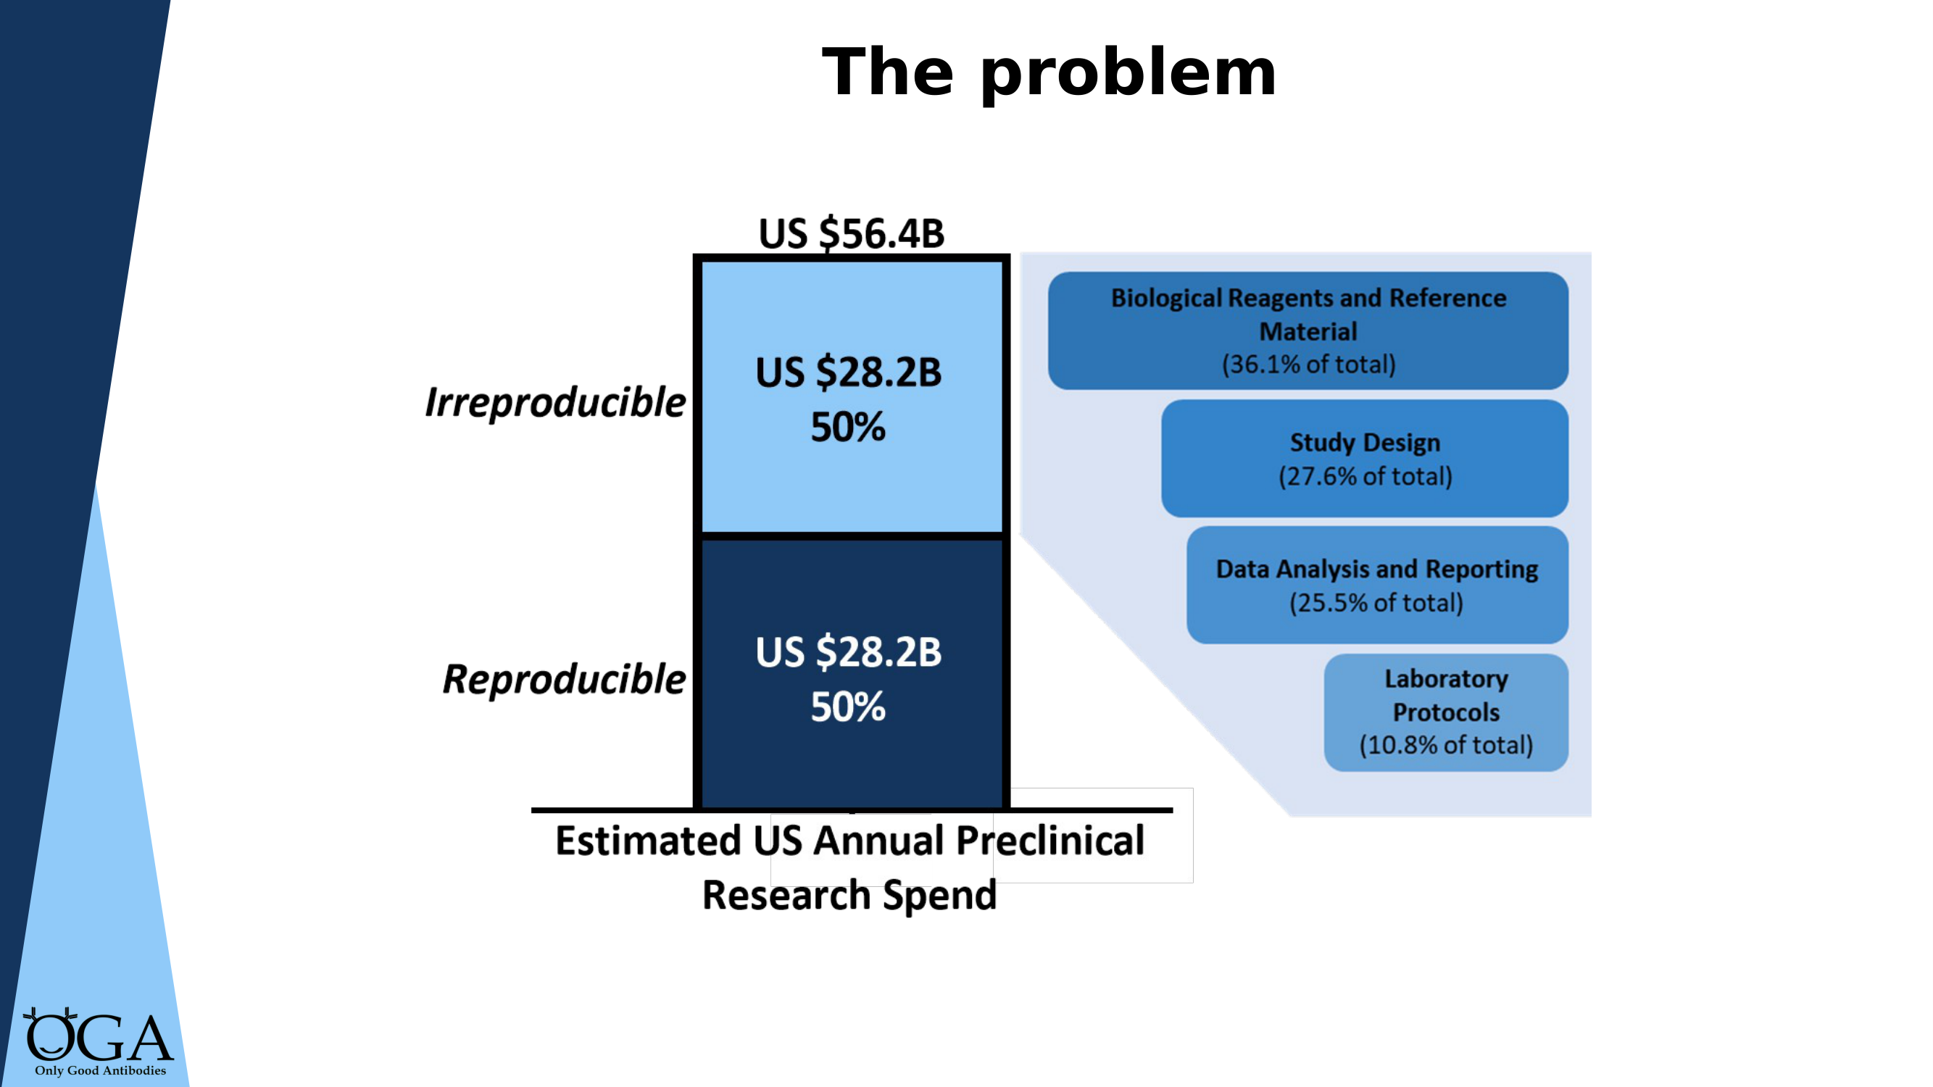
KEY MESSAGE: $28.2 billion per year wasted — biological reagents (including antibodies) are the #1 contributor
Notes:
THE FINANCIAL COST "The estimated annual US preclinical research spend is $56.4 billion. Of that, $28.2 billion — half — goes to research that cannot be reproduced. And the single largest contributor? Biological reagents and reference materials, at 36% of the irreproducibility cost. That's where antibodies sit." Point to the breakdown on the right: biological reagents 36.1%, study design 27.6%, data analysis 25.5%, laboratory protocols 10.8%. Key message: this is not just a quality issue — it's a massive financial problem.

Slide 5
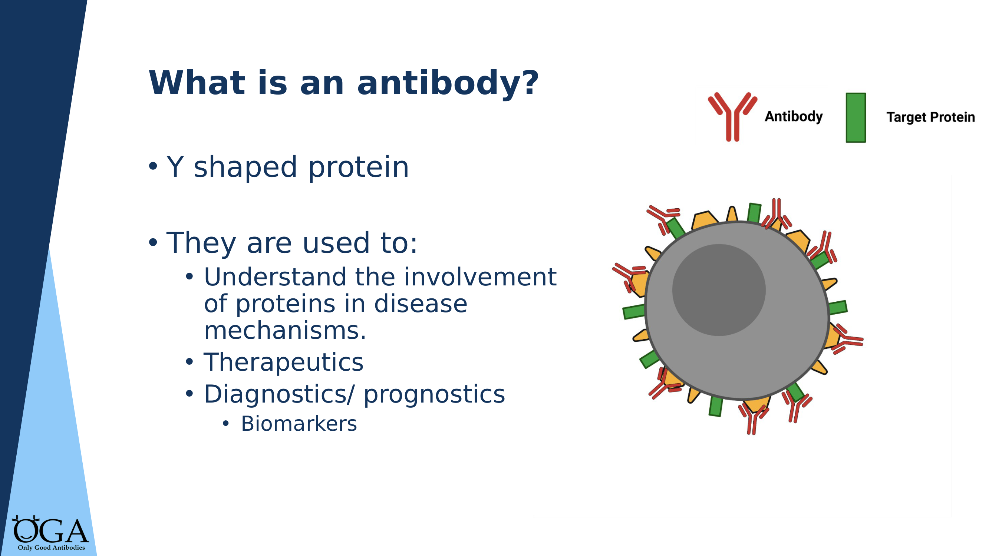
KEY MESSAGE: Antibodies are fundamental tools across biomedical research — if they don't work, nothing downstream is reliable
Notes:
WHAT IS AN ANTIBODY? "Antibodies are Y-shaped proteins used across almost every area of biomedical research. They're used to understand protein involvement in disease, as therapeutics, as diagnostics, and as biomarkers." This slide is a quick orientation for mixed audiences. If your audience already knows this, move through it quickly. The point is to establish that antibodies are everywhere — which makes their quality critical. Note: some audience members may primarily think of therapeutic antibodies. Emphasise that research-grade antibodies (for WB, IF, IHC, FC) are the focus here.

Slide 6
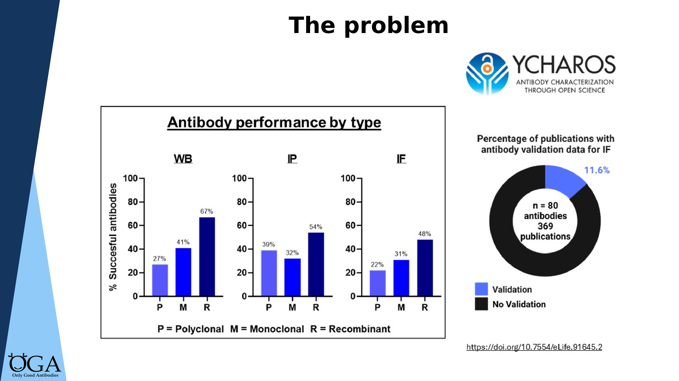
KEY MESSAGE: Over half of antibodies fail rigorous testing — and validation evidence is almost never presented in publications
Notes:
THE SCALE OF THE PROBLEM Two key findings on this slide: LEFT — Antibody performance by type (YCharOS data, 614 antibodies). Recombinant antibodies consistently outperform polyclonals and monoclonals across WB, IP, and IF. Pass rates: polyclonal 27% (WB), recombinant 67% (WB). RIGHT — The donut chart shows that only ~11% of publications using these antibodies for IF presented any validation data. "So more than half of antibodies fail rigorous testing, recombinant antibodies perform best, and the published literature almost never shows validation evidence. That's the gap your work as a Champion helps close." Reference: Ayoubi et al., eLife 2023.

Slide 7
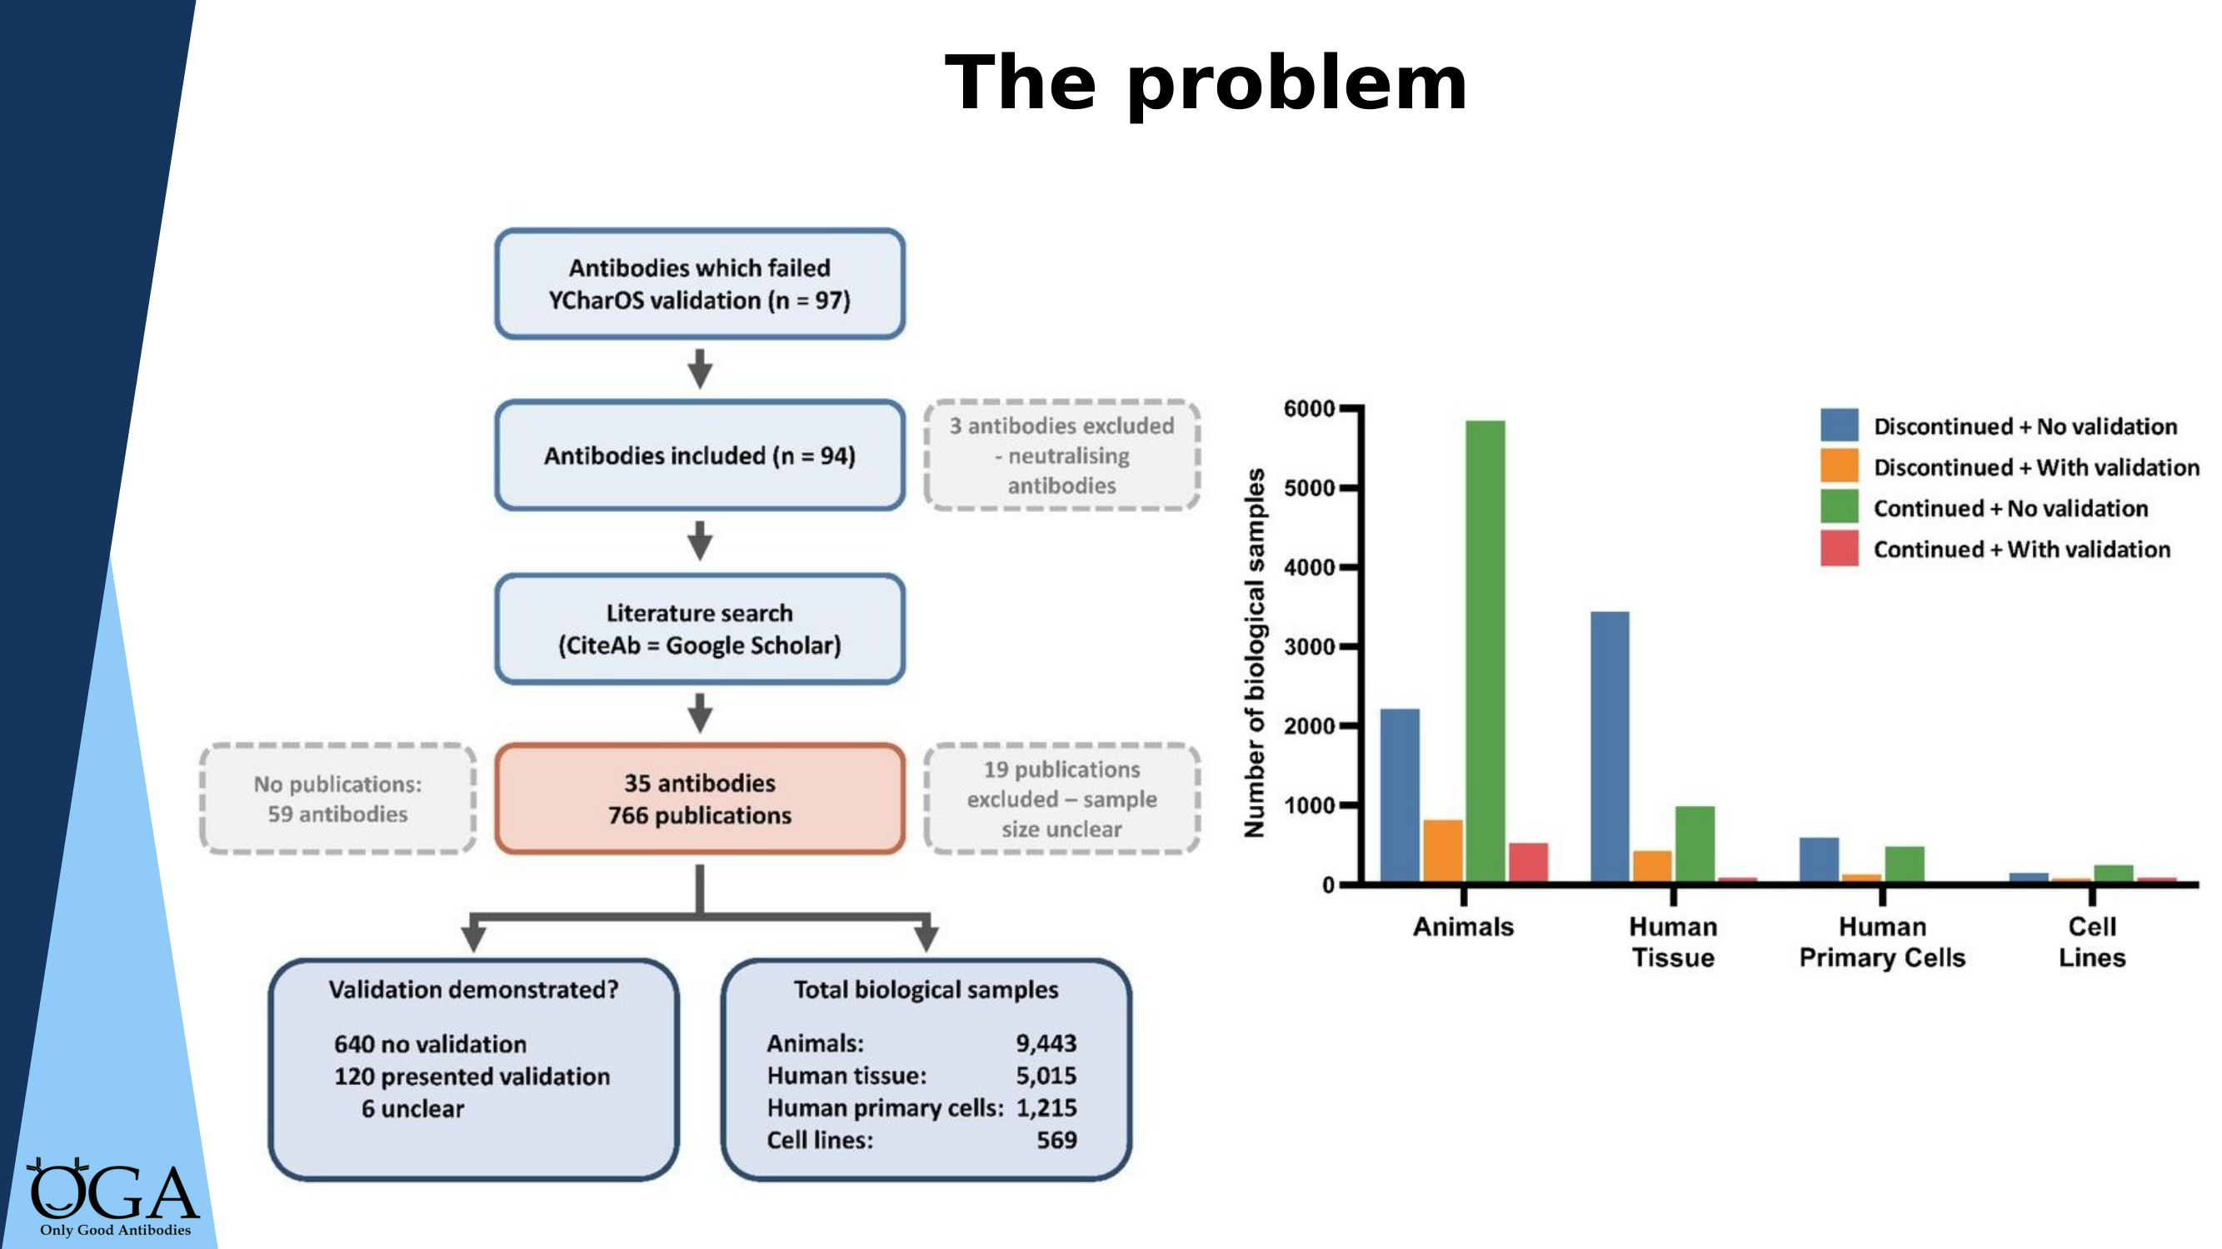
KEY MESSAGE: Failed antibodies don't just waste money — they consume animal and patient samples that can never be recovered
Notes:
THE ETHICAL COST [This is the slide that usually gets the strongest reaction. Slow down here.] This flowchart traces what happens downstream when antibodies fail. From 97 failing antibodies, 760 publications were traced. The overwhelming majority of biological samples were consumed without any validation evidence. "At least 8,064 animal samples and 4,424 human tissue samples were consumed in studies using antibodies with demonstrated poor performance — without presenting any validation data. Human tissue is donated by patients and families who trust it will advance knowledge. Animals are used under ethical frameworks that require minimising waste. Neither obligation is being met when antibodies don't work." Reference: Biddle, Cooper, Blades et al. (2026).

Slide 8
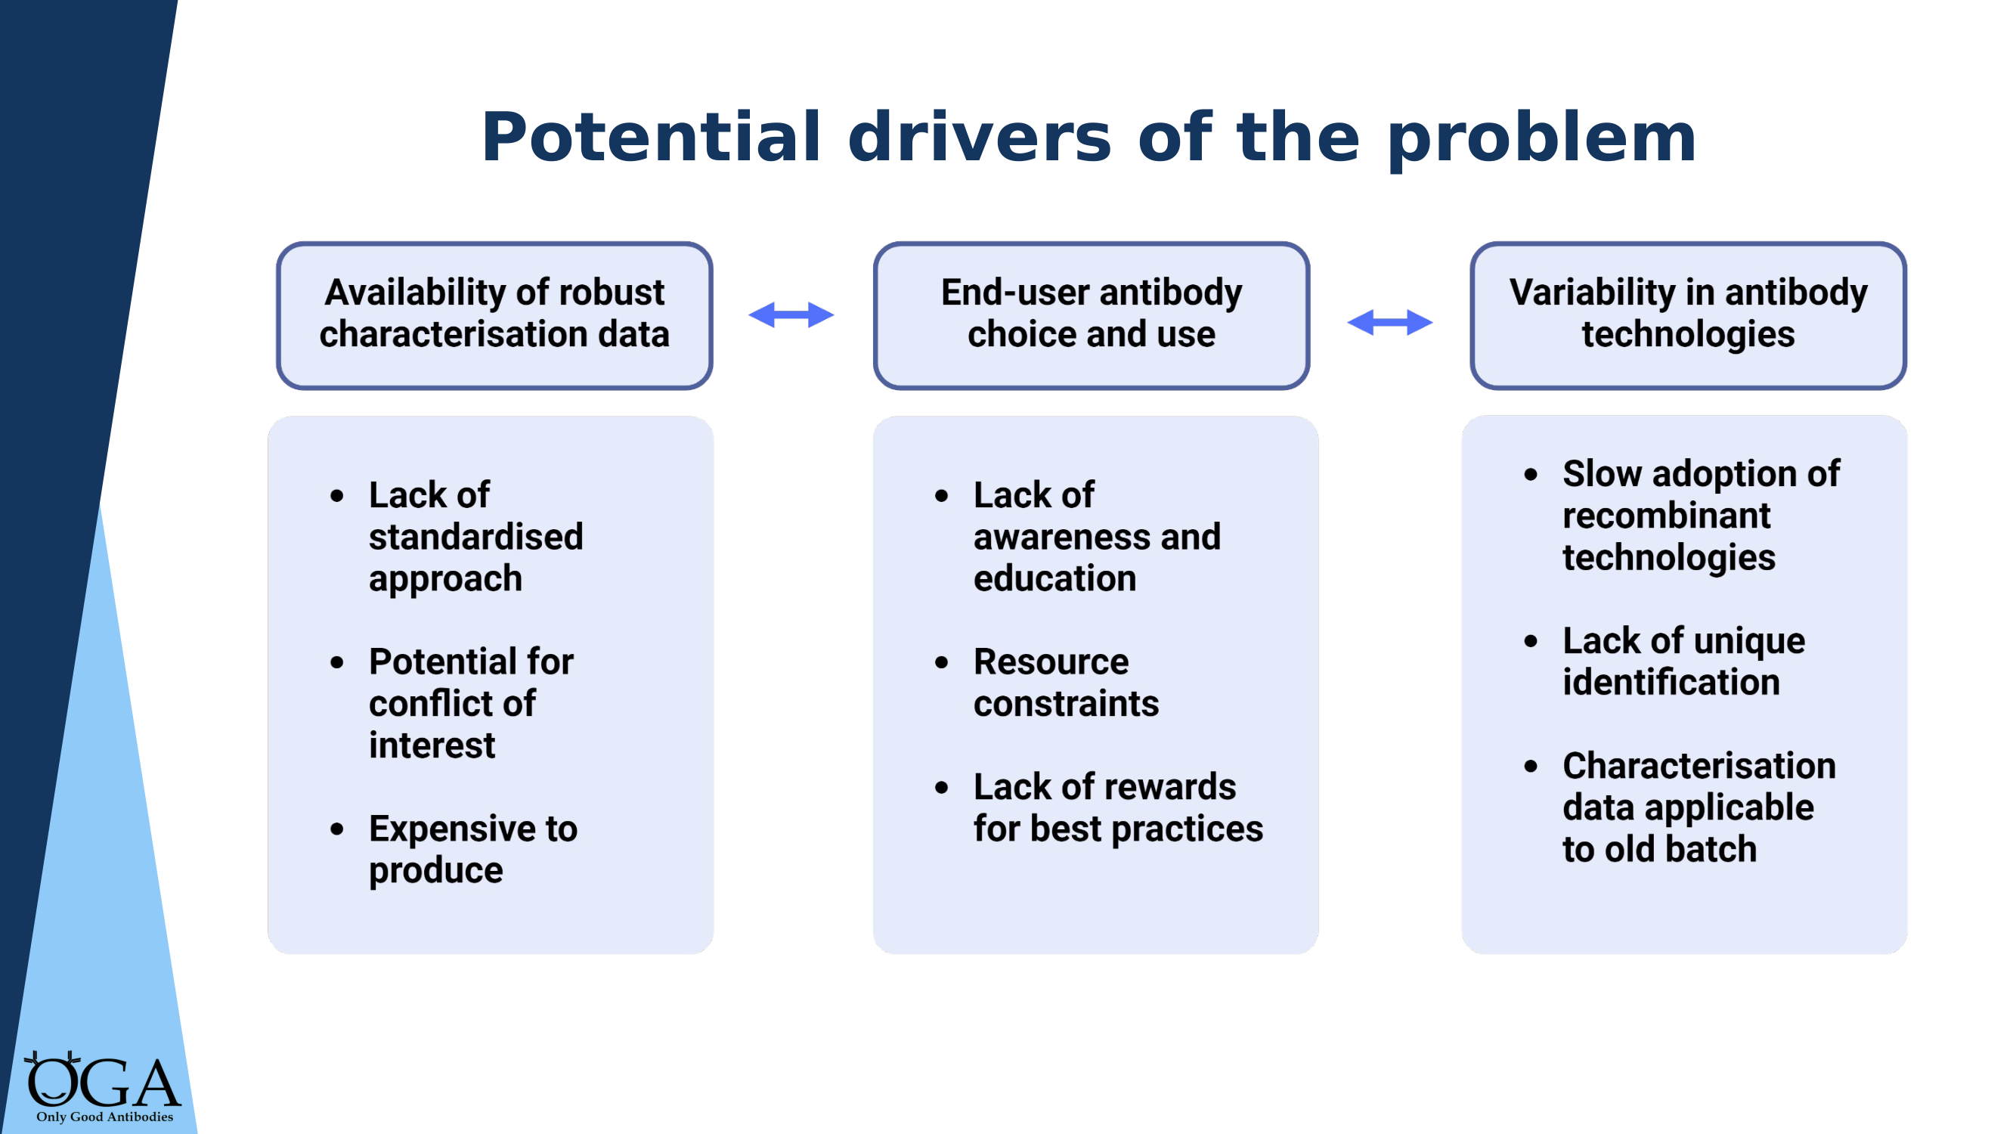
KEY MESSAGE: The problem is systemic — not individual failure. Three interconnected barriers need coordinated action.
Notes:
WHY DOES THIS PERSIST? Three interconnected drivers: 1. AVAILABILITY OF ROBUST DATA — lack of standardised approaches, potential conflict of interest (vendors testing their own products), and expense. 2. END-USER CHOICE AND USE — lack of awareness and education, resource constraints, and no rewards for best practice. 3. VARIABILITY IN ANTIBODY TECHNOLOGIES — slow adoption of recombinant, lack of unique identification (RRIDs), and characterisation data tied to old batches. "This is not about individual researchers being careless. It's about a system that doesn't make good practice easy. That's what we're trying to change — and that's where you come in as a Champion."

Slide 9
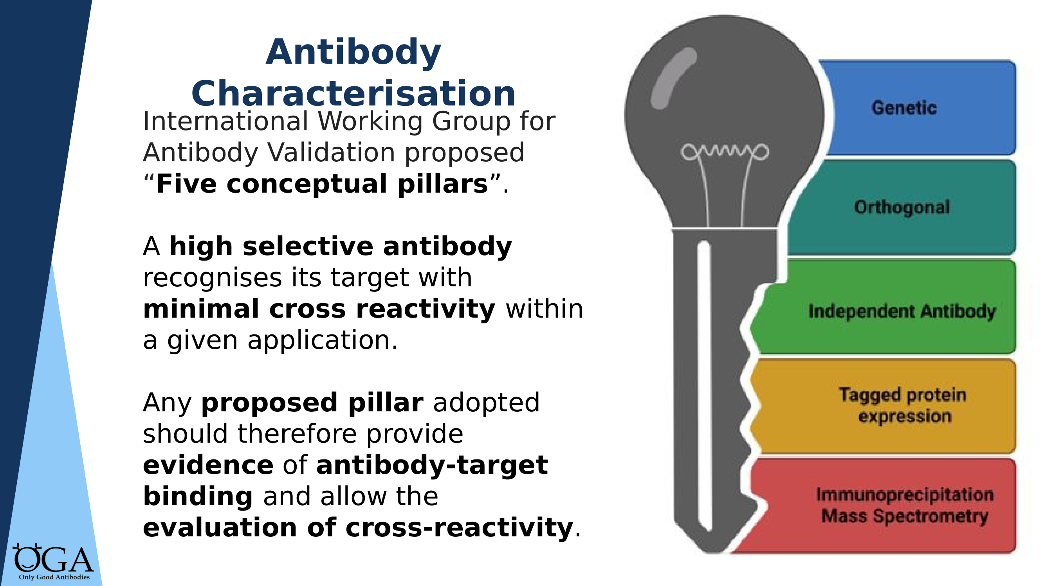
KEY MESSAGE: Five validation strategies exist — genetic approaches give the strongest evidence
Notes:
ANTIBODY CHARACTERISATION — THE FIVE PILLARS The IWGAV framework: genetic, orthogonal, independent antibody, tagged expression, and IP-mass spectrometry. "A highly selective antibody recognises its target with minimal cross-reactivity within a given application. The key word is 'within a given application' — an antibody that works for Western blot may not work for immunofluorescence." You don't need to teach each pillar in detail — the e-learning (Module 2) covers this thoroughly. The key message is: - Genetic strategies (KO/KD) are the gold standard - But they're not always feasible - When they're not, combine other pillars Direct people to Module 2 of the e-learning for the detail.

Slide 10
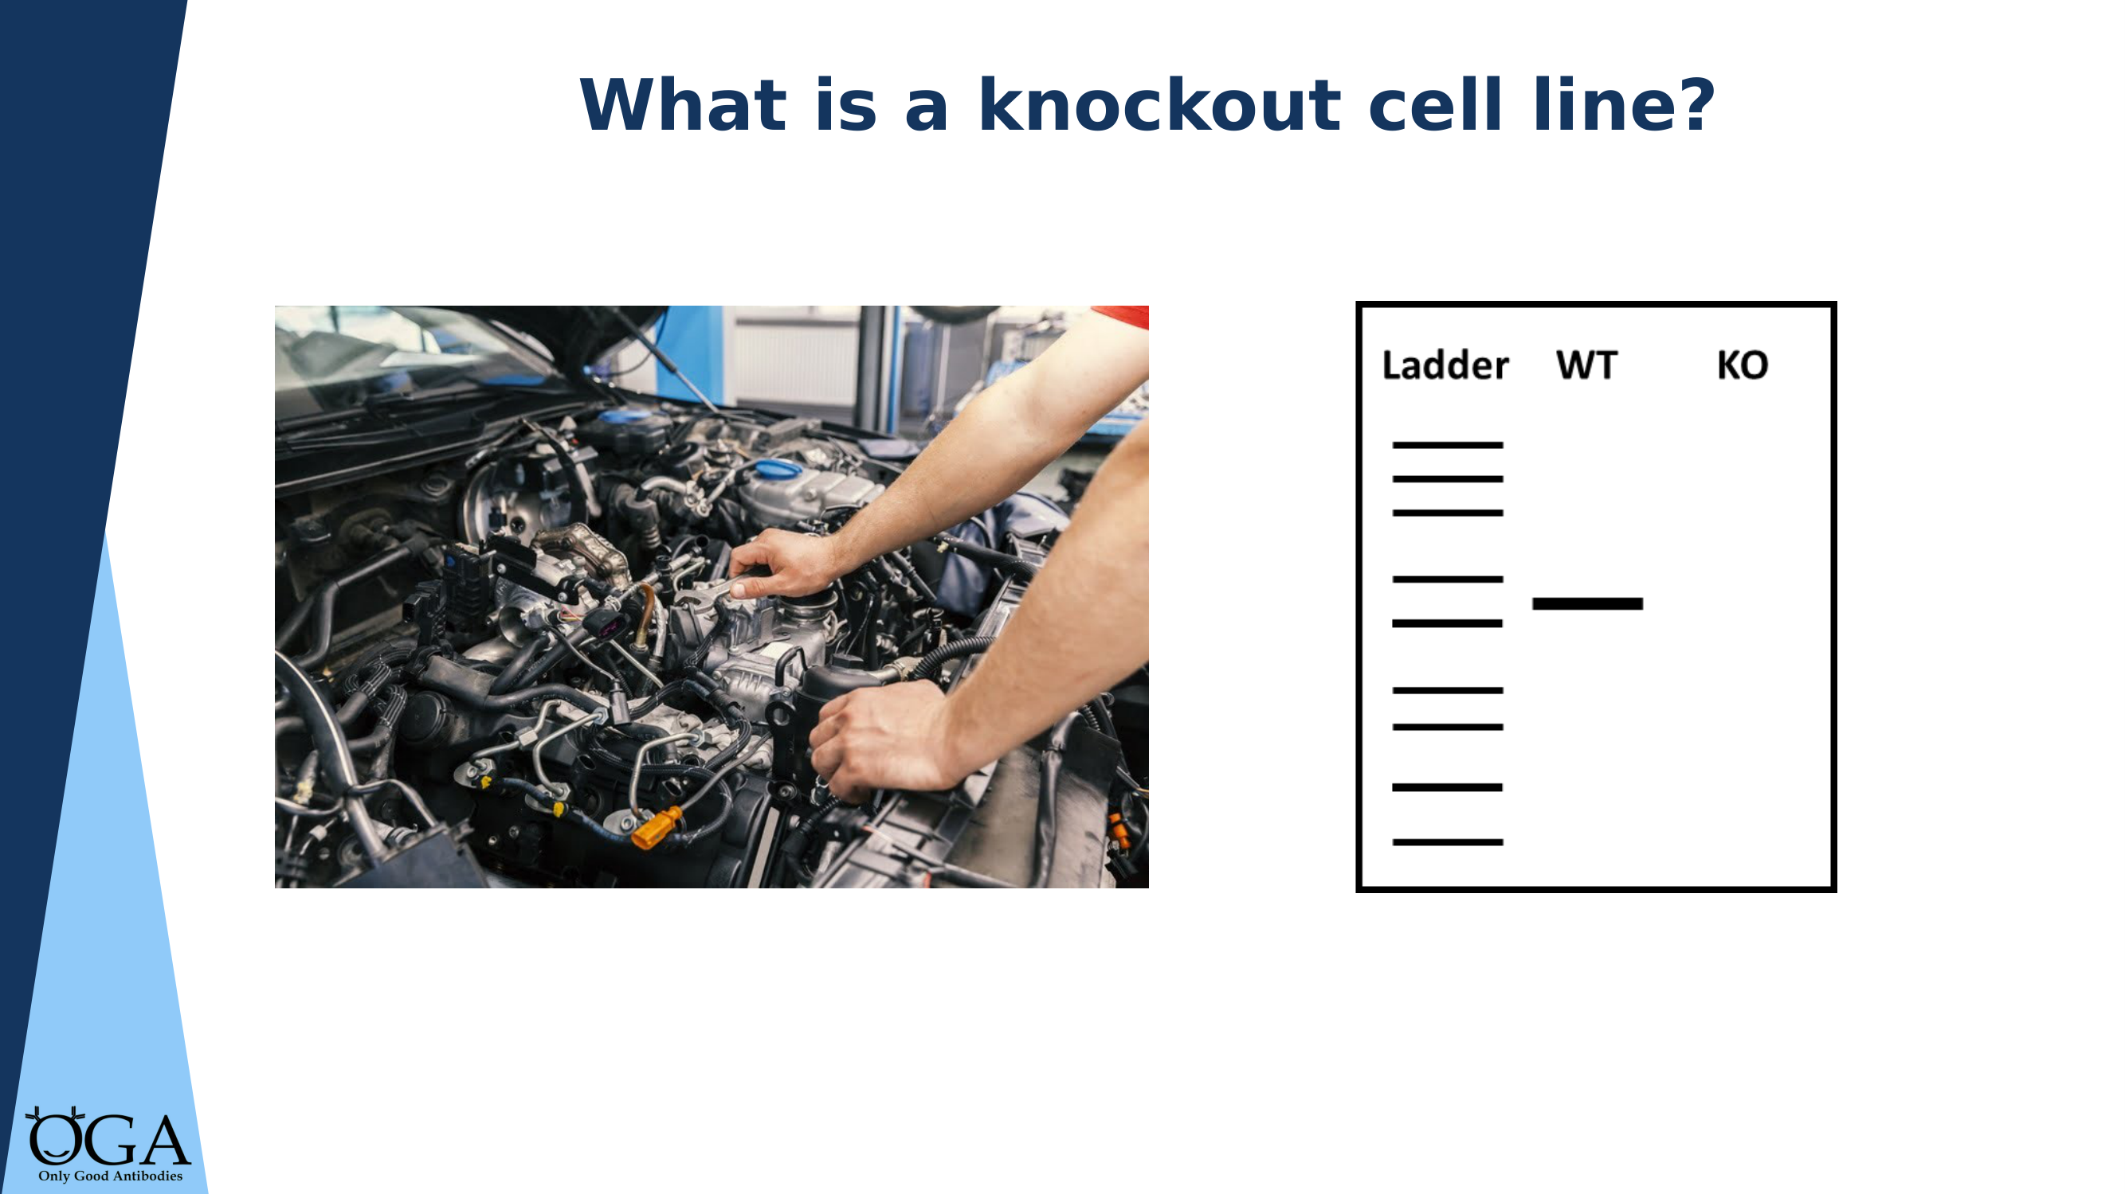
KEY MESSAGE: A knockout cell line is the most powerful control — if the antibody signal disappears in KO, it's specific
Notes:
WHAT IS A KNOCKOUT CELL LINE? "Think of it like a car engine. The wild-type cell is a complete engine with all parts. The knockout cell has one specific part removed. If you test an antibody on both and the signal disappears in the knockout, you know the antibody was detecting that specific part — not something else." This analogy works well for non-specialist audiences. For molecular biologists, you can go into more technical detail about CRISPR, homologous recombination, etc. Key point: this is why the OGA database is so valuable — it shows antibody performance tested against knockout cell lines.

Slide 11
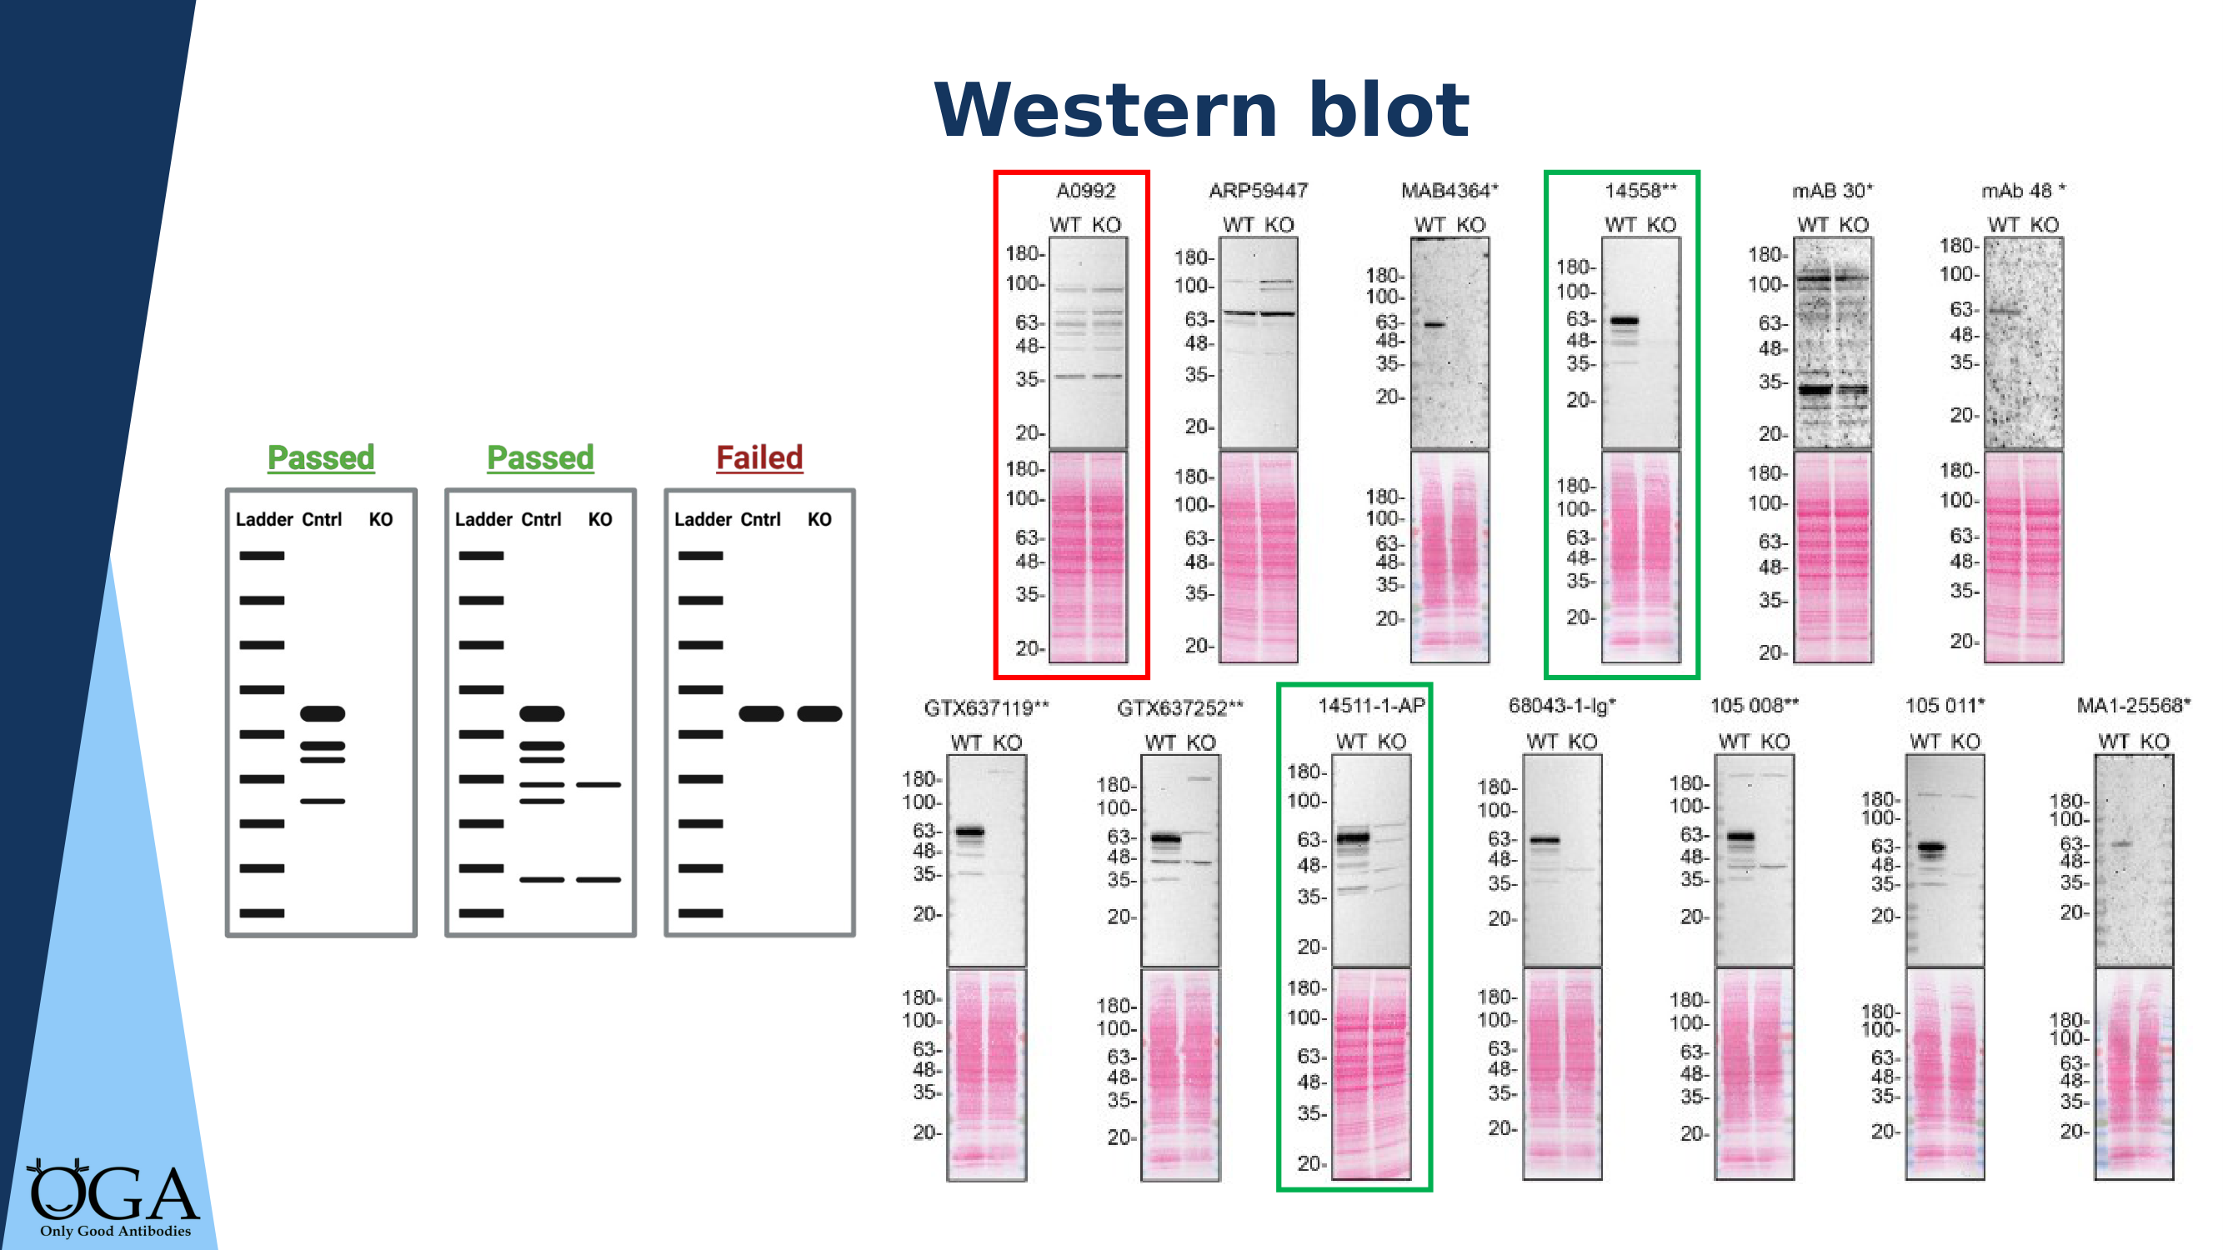
KEY MESSAGE: This is what good characterisation data looks like — a clear band at the right size in WT, absent in KO
Notes:
REAL DATA: WESTERN BLOT Walk through one or two examples: "Each pair of lanes shows the same antibody tested against wild-type (protein present) and knockout (protein deleted) cells. Passed antibodies show a clear band in WT at the expected molecular weight, with that band absent in KO. Failed antibodies show bands in both, or bands at the wrong size." Point out the recombinant antibody if visible — note that it tends to give cleaner results. Reference: YCharOS / Ayoubi et al.

Slide 12
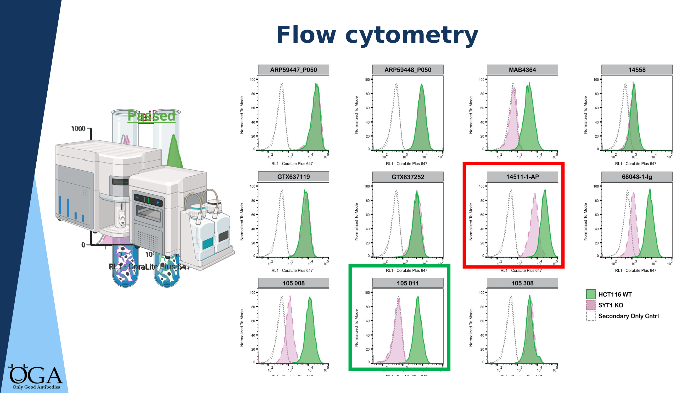
KEY MESSAGE: Flow cytometry — look for clear separation between WT and KO populations
Notes:
REAL DATA: FLOW CYTOMETRY "For flow cytometry, you're looking for clear separation between the WT signal and the KO signal. Passed antibodies show the WT histogram shifted clearly to the right compared to KO. Failed antibodies show overlapping populations." The red-boxed examples show failures — point these out. This slide is most relevant for immunology and cell biology audiences. Skip or abbreviate for others.

Slide 13
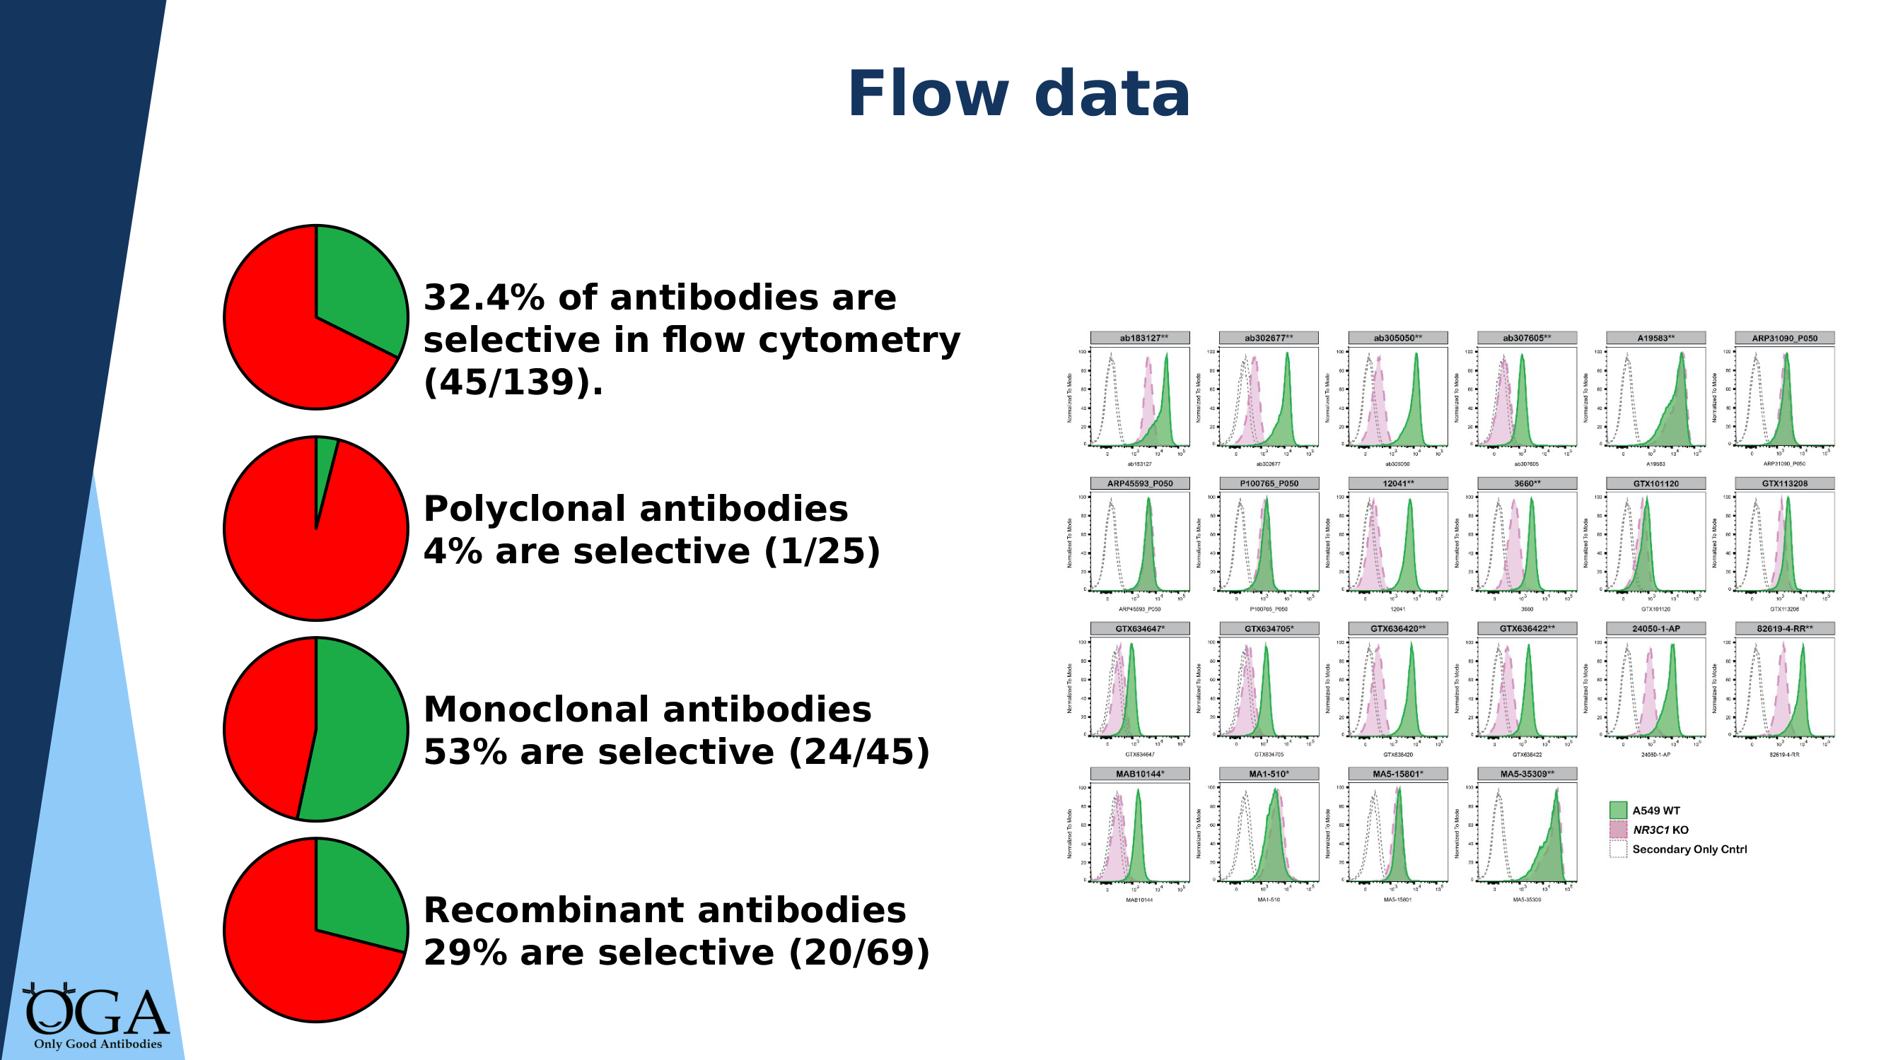
KEY MESSAGE: Only 32% of flow antibodies pass — monoclonals perform best for flow, but check the data
Notes:
FLOW CYTOMETRY SUMMARY "Only 32.4% of antibodies tested are selective in flow cytometry. Breaking it down by type: polyclonal antibodies — only 4% pass. Monoclonal — 53% pass. Recombinant — 29% pass." Note: flow cytometry is the one application where monoclonals can outperform recombinants in the current dataset. This is worth mentioning if asked. Skip this slide if the audience doesn't use flow cytometry.

Slide 14
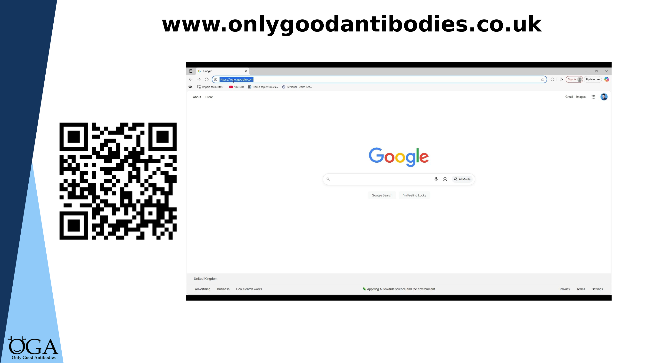
KEY MESSAGE: All this data is freely available — search by gene name at onlygoodantibodies.co.uk
Notes:
THE OGA DATABASE "Everything I've shown you is freely available. Go to onlygoodantibodies.co.uk, type in your gene name, and you can see which antibodies have been tested, which passed, and in which applications." If doing a live demo, show the Google search route as well — many people will find OGA through Google rather than directly. This is a good point to mention CiteAb and BenchSci as complementary tools. Direct people to e-learning Module 3 for a full walkthrough of the database.

Slide 15
What you can do now
Check the evidence
Before your next antibody purchase, search onlygoodantibodies.co.uk
Complete the e-learning
4 free modules at onlygoodantibodies.co.uk/academy (~45 min total)
Join a workshop
Bring your real antibody selection problem — I can help you search
Spread the word
Share the video and e-learning with your lab group or supervisor
I’m your local Antibody Champion — reach out for help any time.
Notes:
CLOSING SLIDE End with concrete actions, not a generic 'thank you.' "Here's what I'd like you to do: 1. Before your next antibody purchase, take five minutes to check the OGA database. It could save you months. 2. Complete the free e-learning — Modules 1 and 2 take about 25 minutes total and cover everything I've talked about today in more detail. 3. If you have a real antibody selection decision to make, come to one of my workshops. I'll help you search the databases and find the best-evidenced options for your target. 4. Share this with your lab group, your supervisor, your collaborators. The more people who know about this, the faster things change. I'm your local Antibody Champion — my door is open. Thank you."

