Slide 1
Antibody choice and use
Key messages for your workshop
Use these slides before moving to live antibody searching.
Notes:
TITLE SLIDE This is the condensed key messages deck for use before the live searching portion of a workshop. You can optionally start with the 'Why antibody choice matters' video before these slides. These 7 slides should take about 10 minutes to present. Then move to live searching with participants' own targets.

Slide 2
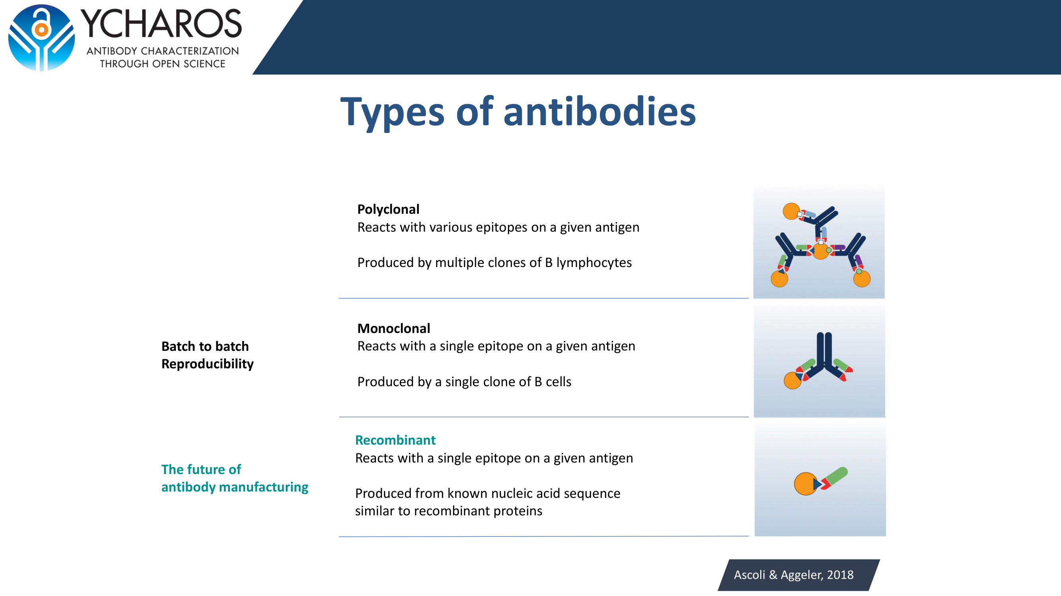
Notes:
TYPES OF ANTIBODIES Three types: polyclonal (multiple epitopes, non-renewable, batch variable), monoclonal (single epitope, renewable in principle but hybridomas can drift), recombinant (single epitope, sequence-defined, fully renewable, lowest batch variability). Key message: recombinant is the future of antibody manufacturing. If a recombinant option exists for your target, prefer it.

Slide 3
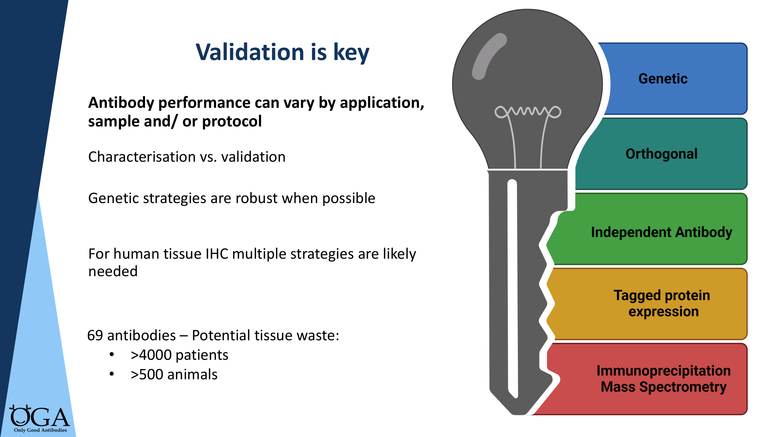
Notes:
VALIDATION IS KEY Antibody performance varies by application, sample, and protocol. Characterisation (what does this antibody do generally?) is different from validation (does it work for MY experiment?). The five pillars: genetic, orthogonal, independent antibody, tagged expression, IP-MS. Genetic strategies are the most robust when feasible. The e-learning (Module 2) covers each pillar in detail. For the workshop, the key point is: genetic validation gives you the strongest evidence, and you should look for it first. Note the waste numbers: 69 antibodies linked to >4000 patient samples and >500 animal samples consumed.

Slide 4
Step 1: Confirm antibody can detect target protein
Knockout
Knockdown
Tagged expression
Requires cell line with expression.
Protein not critical for survival.
Watch for splice variants.
For essential proteins.
Requires efficient KD.
Watch for splice variants.
Requires plasmid + tag.
May not reflect specificity
at endogenous levels.
Step 2: Supportive evidence in your sample of interest
Genetic manipulation
Independent antibody
Orthogonal
Cell treatment
May be first step
if possible.
Two antibodies, different
epitopes. Pattern should
correlate.
Compare with antibody-
independent methods.
Does not rule out
non-specific binding.
Confirm expected change
in staining. Correlate
with RNA/proteomics.
OGA Champions Workshop — Key Messages
onlygoodantibodies.co.uk
Notes:
TWO-STEP DECISION FRAMEWORK This is the practical framework people should take away. Step 1: Can the antibody detect the target at all? Use knockout (strongest), knockdown (for essential genes), or tagged expression (useful but overexpression is an easy test). Step 2: Does it work in YOUR specific sample? Genetic manipulation of your actual cells if possible, independent antibody concordance, orthogonal comparison with non-antibody methods, or showing expected changes with cell treatment. Key message: Step 1 is about the antibody. Step 2 is about your experiment.

Slide 5
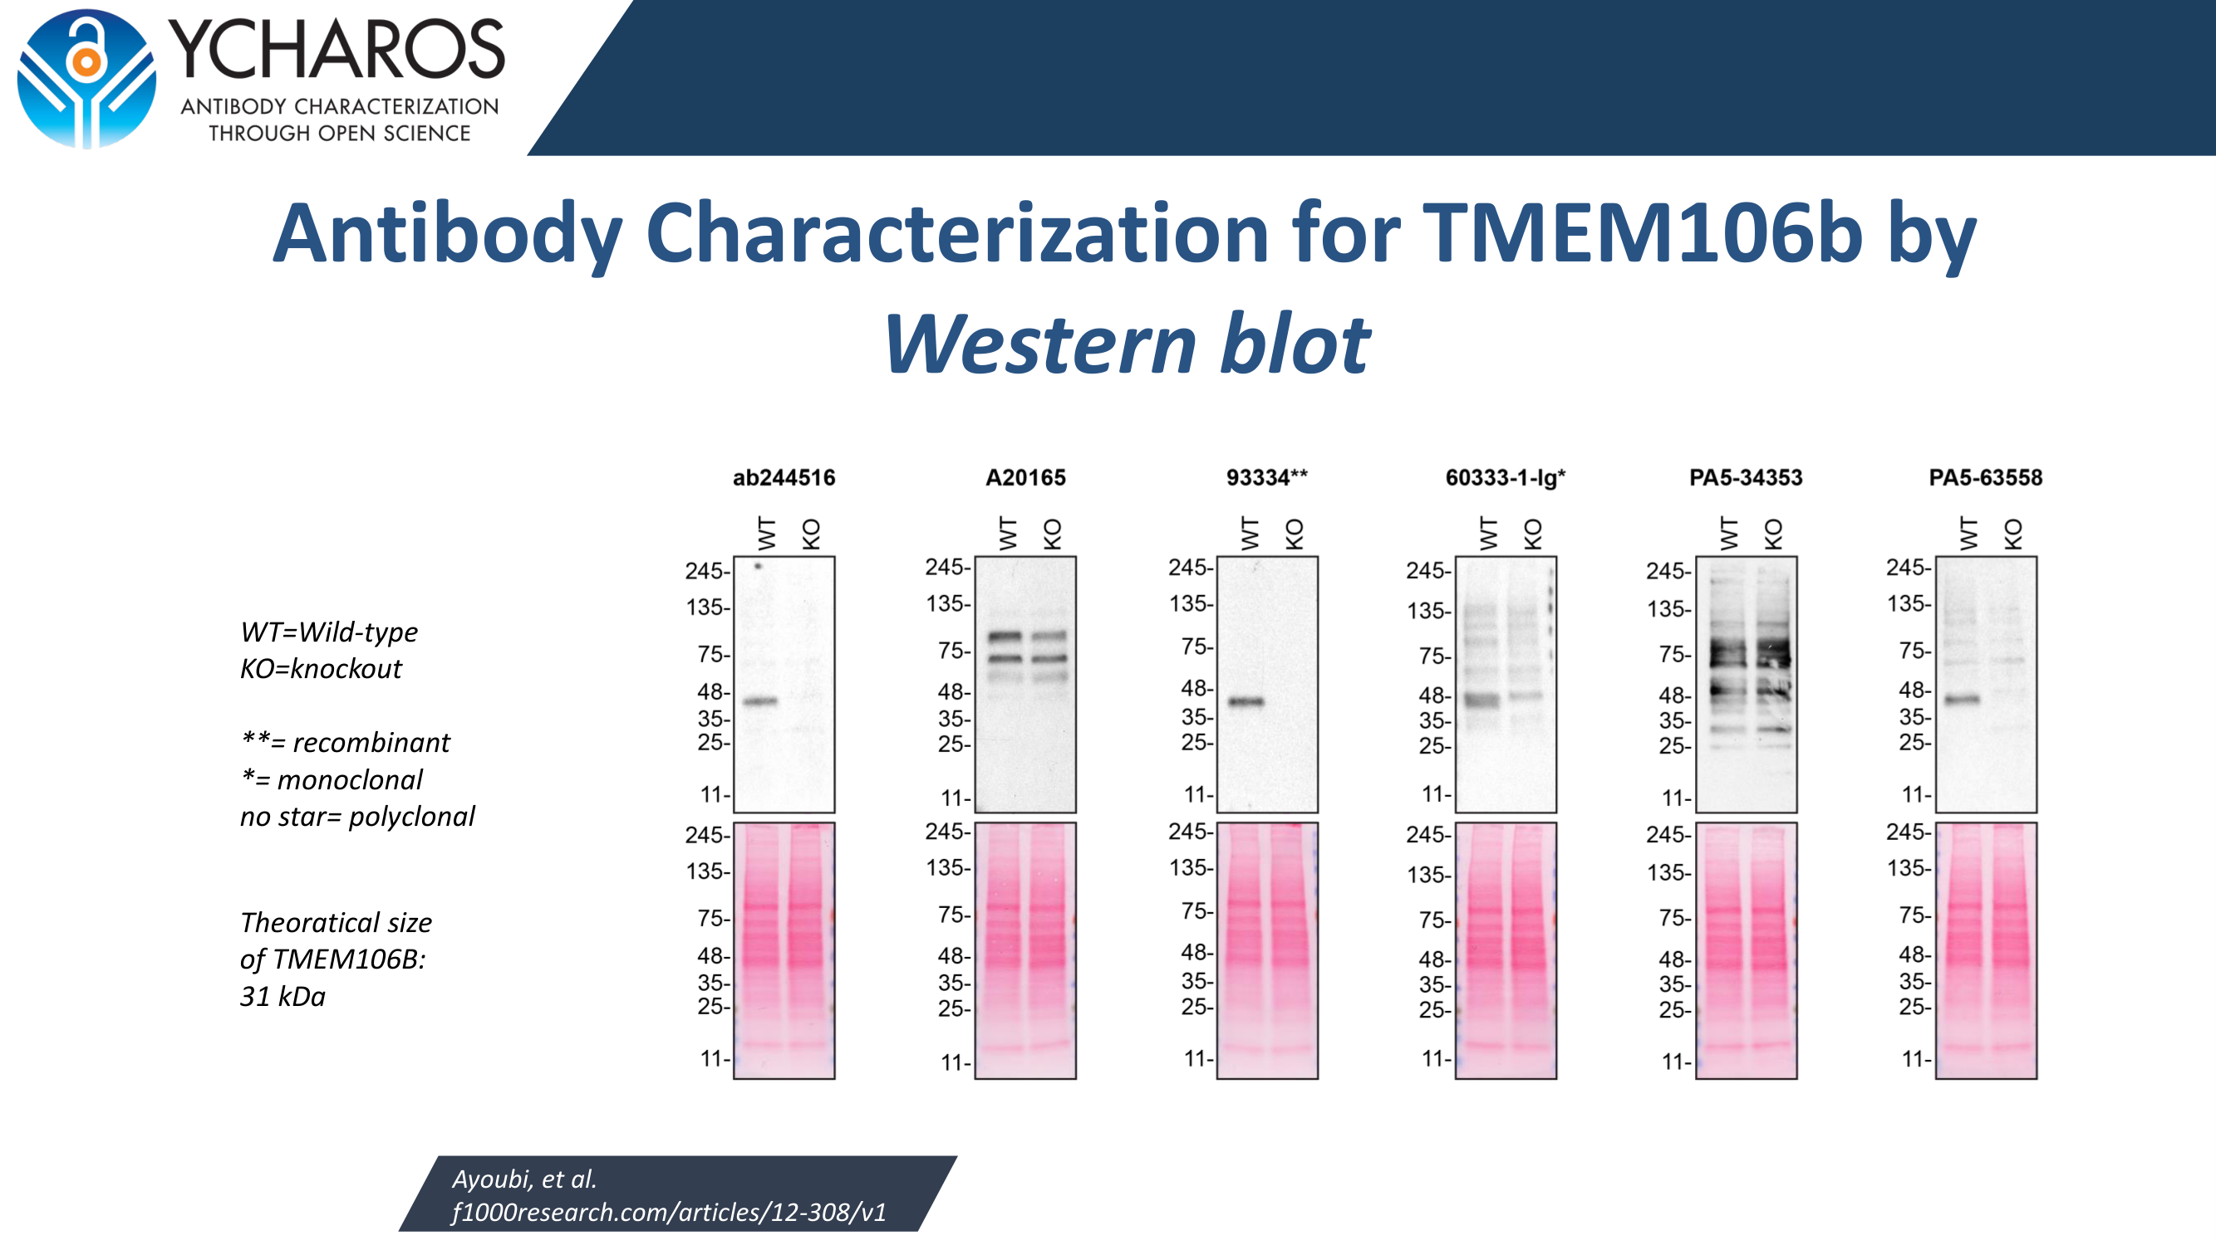
Notes:
WHAT DOES REAL DATA LOOK LIKE? TMEM106b Western blot characterisation from YCharOS (Ayoubi et al., F1000Research). Walk through: WT = protein present, KO = protein deleted. Expected size ~31 kDa. ** = recombinant, * = monoclonal, no star = polyclonal. Point out: ab244516 shows a clean band at the right size in WT, absent in KO — that's a pass. A20165 shows multiple bands at wrong sizes in both lanes — that's non-specific. 93334** (recombinant) shows a clean result. This is exactly the kind of data you'll be looking for during the live searching portion.

Slide 6
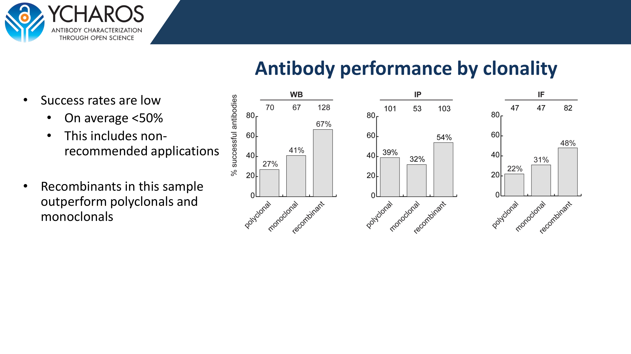
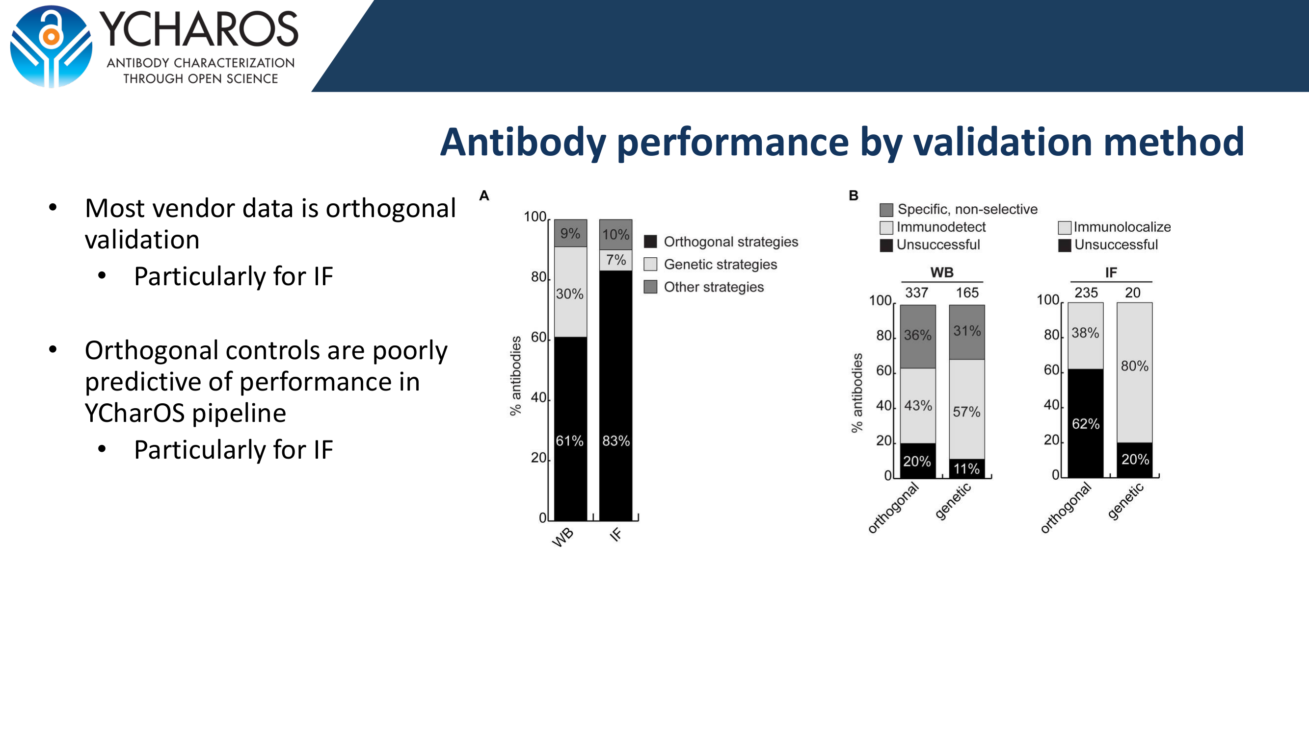
What the data tells us
Recombinant antibodies outperform
Genetic validation is most predictive
Recombinants consistently had the highest
pass rates across WB, IP, and IF.
Orthogonal vendor data poorly predicts
real-world performance, especially for IF.
Look for KO/KD data.
OGA Champions Workshop — Key Messages
onlygoodantibodies.co.uk
Notes:
KEY FINDINGS Two takeaways for antibody selection: 1. CHOOSE RECOMBINANT when available. Pass rates: WB 67% vs 27% (polyclonal), IP 54% vs 39%, IF 48% vs 22%. 2. LOOK FOR GENETIC VALIDATION DATA. Most vendor data is orthogonal (RNA correlation etc.) which is poorly predictive of actual performance — especially for IF where 62% of antibodies with orthogonal-only vendor data failed. Genetic validation (KO/KD) is far more reliable. Practical message: when searching, prioritise recombinant antibodies with knockout-validated vendor data.

Slide 7
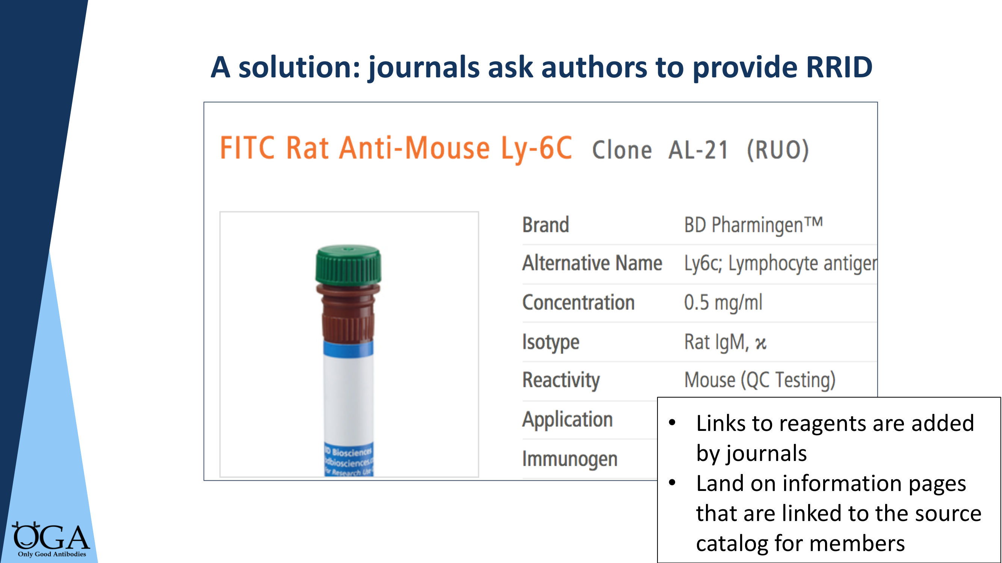
Notes:
RRIDs — REPORTING YOUR ANTIBODY USE When you publish, include the RRID (Research Resource Identifier) for every antibody. This enables others to find exactly which antibody you used. RRIDs link to information pages with source catalogue details. Journals increasingly ask for them. It takes 30 seconds to look up on scicrunch.org. This matters because products get renamed, discontinued, or sold by different vendors. Without an RRID, the next researcher may not be able to identify what you actually used.

Slide 8
Key takeaways
Your antibody might not detect the protein you think
Validation is vital — and context-specific
Genetic strategies (KO/KD) give the strongest evidence
Recombinant antibodies perform better and are more reproducible
Look for genetic validation data when choosing antibodies
Report your antibodies with RRIDs
Now let’s find good antibodies for your targets.
Notes:
SUMMARY + TRANSITION Run through the six points quickly, then transition to the live searching portion. 'OK, those are the key principles. Now let's put them into practice. Who wants to go first? Tell us your target protein and which application you need it for, and we'll search together.' From here, follow the workshop framework: Google → OGA → CiteAb/BenchSci → HCDM if relevant → Resource Pack.

